Slide 1

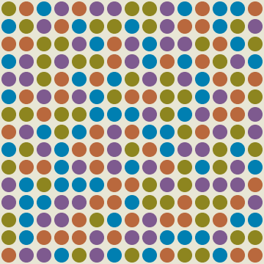
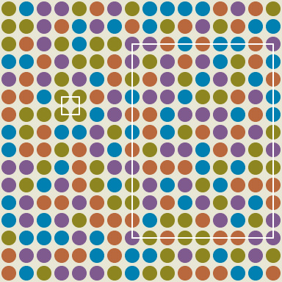
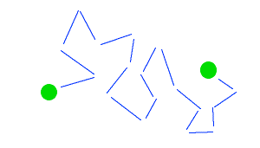
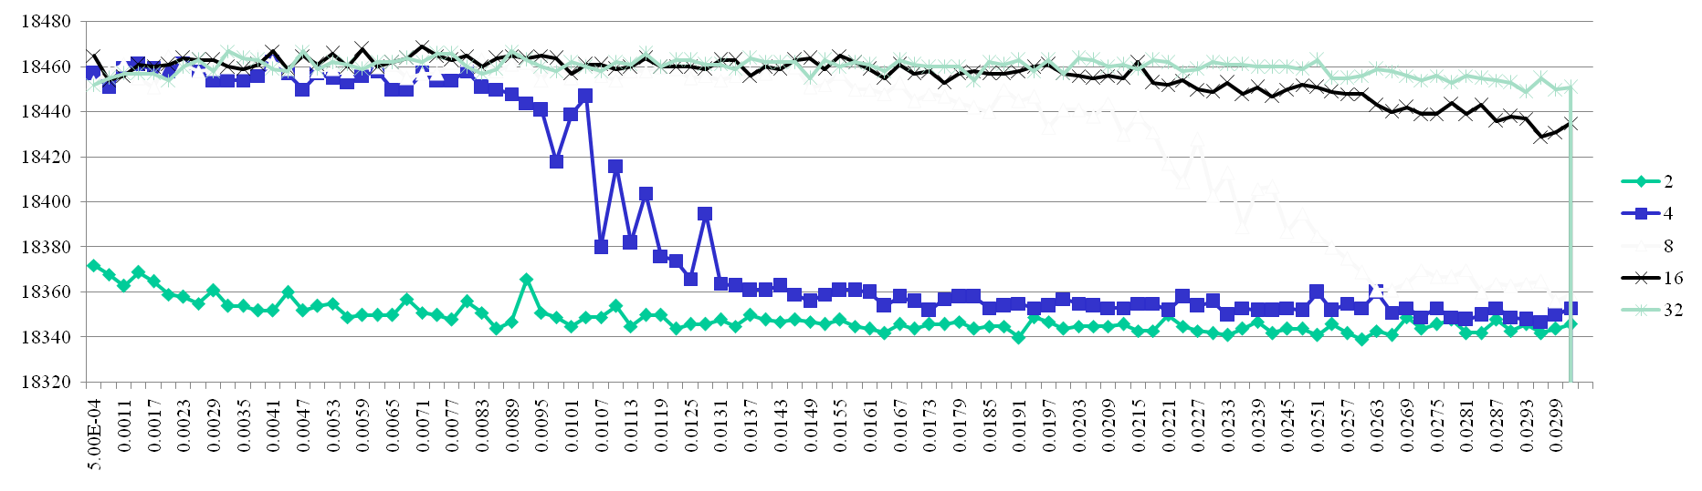
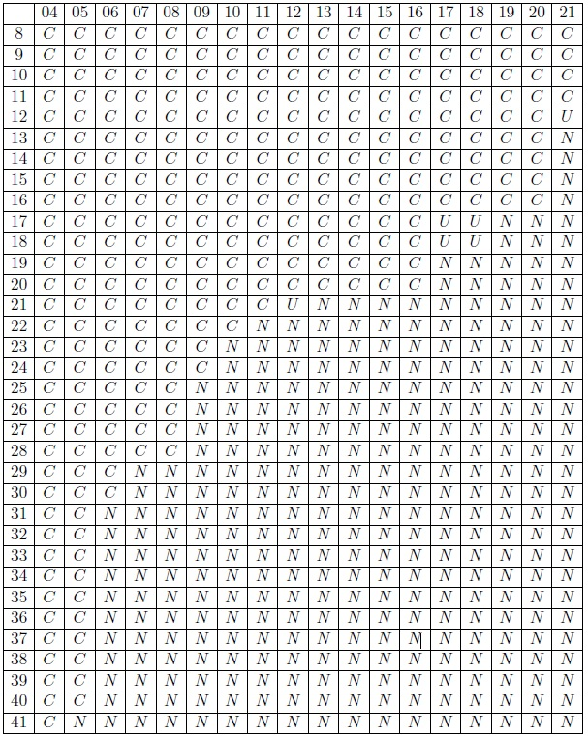
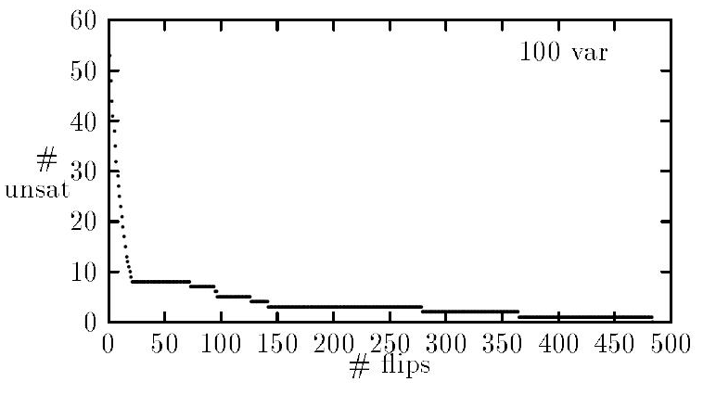
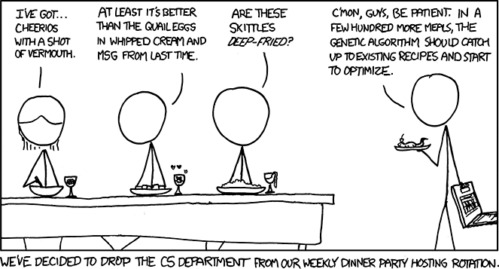
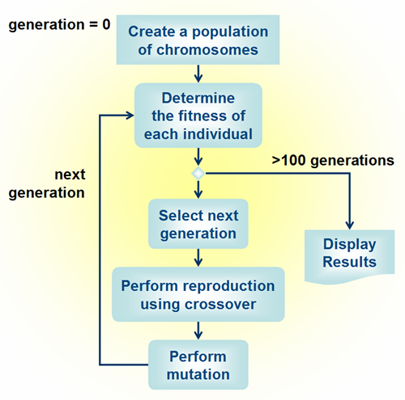
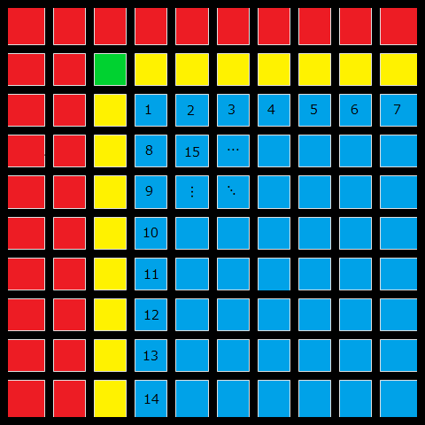
Rectangle Free Grid Coloring
A SAT/Genetic Algorithm Based Approach
Abstract: Given an N x M grid, is it possible to color the grid using only C colors in such a way that no rectangle in the grid has four corners of the same color? For instance the colorability of a 17x17 grid using 4 colors is unknown. It is conjectured that this grid is colorable with 4 colors. However, a brute force attempt to find a valid coloring is computationally infeasible, as there are 10¹⁷³ different possible colorings of this grid. Hence, it is necessary to devise a clever algorithm in order to solve this problem. We investigate methods using Genetic Algorithms, Satisfiability Solutions, and hybrid approaches to determine the colorability of a 17x17 grid.
Michael Groh, Paul Varoutsos
Advisor: Dr. Ganesh R. Baliga
Department of Computer Science
Grid Coloring Defined
DPLL-Based SAT-Solvers
ECJ Open Source Library
“A two-dimensional grid is a set G_{n,m} = [n] × [m]. A grid G_{n,m} is c-colorable if there is a function X_{n,m} : G_{n,m} [c] such that there are no rectangles with all four corners the same color.”
Our initial attempt to solve the grid coloring problem via SAT-Solvers was to use DPLL-based SAT-Solvers. The DPLL algorithm is a complete, backtracking algorithm for determining the satisfiability of a propositional logic formula. After much experimentation, we have found that the SAT-Solver known as Minisat was able to solve grid coloring SAT problems most effectively. However, despite being one of the most efficient SAT-Solvers available today, Minisat was not able to solve grids any larger than 15x15, taking up to 45 minutes to determine a solution. As a result of this, we looked into alternative SAT-Solver algorithms such as GSAT and WALKSAT.
ECJ is an evolutionary computing library that can be used as a driving force for genetic algorithms and genetic programming.
In our ECJ based approach to the problem we defined a fitness function. Fitness of individuals was determined by validating each grid that ECJ generated and calculating how many rectangles each grid yielded. Using our validation code, ECJ used breeding of the individuals with the highest fitness to narrow down a solution based on how close each individual assignment was to a completely rectangle free grid.
A valid 4-coloring of 15x15
A 16x16 grid containing monochromatic rectangles.
WalkSat
Shown here is a grid containing the known and unknown 4-colorable grid dimensions. We attempt to color the 17x17 grid which has been conjectured to be
4-colorable.
WalkSat implements a variation to the GSAT algorithm, which unlike the DPLL algorithm, is not complete. This means that for a given SAT instance, WalkSat will never be able to determine unsatisfiability. The algorithm will continue trying to find a solution indefinitely.
WalkSat has been shown to be very successful solving SAT instances, especially in the domain of graph coloring. Our research showed that the WalkSat was able to outperform DPLL in all grid sizes.
WalkSat began to fail when trying to solve the 17x17 grid. However, it is able to generate close approximate colorings containing only a few rectangles which inspired us to use these approximate solutions in hybrid approaches.
Hybrid Approaches
We have determined that each of our algorithms aforementioned were not powerful enough to solve our problem alone. For this reason we decided to merge several solution strategies together.
WalkSat to DP
Sat Based Approach
We used the power of WalkSat to generate grid colorings of smaller grid sizes and used these as partial colorings for larger grid sizes. We attempted to utilized the property that every colorable n x m grid has a n-1 x m-1 colored grid contained inside of it. We attempted to color the 17x17 grid with this bottom up approach.
This approach was accomplished by creating a script that uses WalkSat to generate a grid coloring for a small grid, for example 12x12, inserting this grid into the larger 17x17, then using a DPLL-based SAT-Solver such as Minisat to exhaust all possible combinations for the remaining uncolored squares, then repeating thee process thousands of times for different small grid colorings.
We decided to take the rectangle free grid coloring problem and map it to an instance of the Boolean SAT problem. SAT, or Satisfiability, is the problem of determining whether or not the variables of a propositional logic formula can be manipulated in such a way to make the formula evaluate to true. When the grid coloring problem is mapped to SAT, we can run the instance on several SAT-Solvers using different techniques.
This graph compares number of variable flips to the number of satisfied clauses
The Mapping
The mapping involves three types of constraints in order to
represent the grid coloring problem as a Boolean formula:
1. Each square must contain at least one color.
2. Each square must contain at most one color.
3. For each sub-rectangle in the n by m grid, no four corners should have the same color.
Evolutionary Computation
WalkSat to ECJ
There are two types of evolutionary computation, genetic programming and genetic algorithms. For our project we used genetic algorithms which involve evolutionary theory by “breeding” partial solutions together based on their fitness to form a better solution.
Evolutionary computation requires a great deal of luck in order to find a solution in such a large search space. WalkSat’s algorithm was the best at quickly finding approximate solutions and for this reason we can use the best solutions of WalkSat use them as individuals in our genetic algorithm approach. This will increase the odds of ECJ breeding to find the correct solution by saturating the starting population with highly fit individuals.
This is an example of the rectangles that we are looking for.(Left)
p cnf 1104 8800
111 112 113 114 0
121 122 123 124 0
-111 -112 0
-111 -113 0
-111 -121-211 -221 0
-112 -122 -212 -222 0
(Constraint 1)
Conclusion
…
(Constraint 2)
In conclusion we were unable to generate a fully colored 17x17 grid. Our closest grid coloring came within 9 rectangles. Our research is ongoing and there are still a lot of possibilities and algorithms to investigate. We believe that very close approximations can be found using an Evolutionary Algorithm approach by saturating the population with very fit solutions generated via a SAT-Solver.
…
(Constraint 3)
…
The contents of a 10x10 grid’s CNF file(Right)

